Slide 1
Deep Supermarket Transfer Learning Approach for Classification of Indian Supermarket Products
Reg No: 20BCE1506
Name: Varun Verma
Guide: Dr. Noel Jeygar Robert V

Slide 2
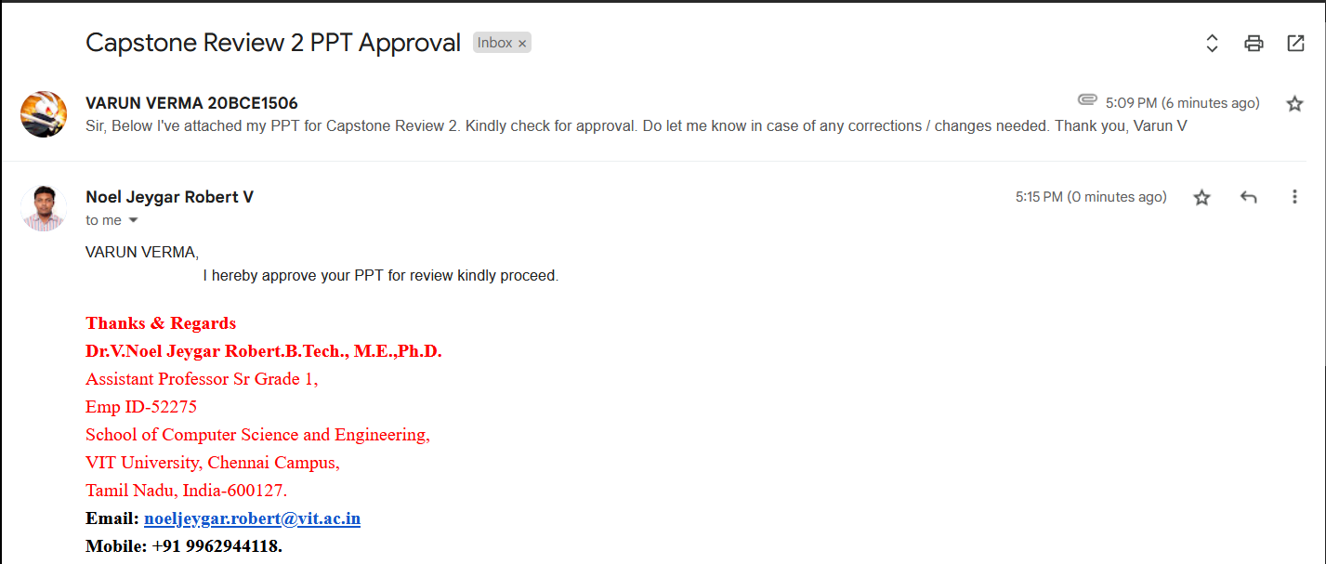
Guide Approval mail snapshot

Slide 3
Outline
Introduction
Literature Review
Themes Discovered
Gaps Identified
Research
Challenges Addressed
Objectives of paper
Problem Statement
Methodology Diagram
Data Collection Methods
Proposed System Diagram
Implementations
Dataset Stats
Class Distributions
Models
CNN (Custom Model)
EfficientNetB7 (TL)
Results
Findings & Interpretations

Slide 4
Introduction
This research aims to “develop an advanced image classification model for supermarket products, leveraging DNN algorithms and to evaluate performance in product categorization of modern Indian retail”.
Background of the problem
The growing need for intelligent technologies for autonomous product categorization in retail settings, particularly in automated retail storage and self checkout terminals, necessitates the development of specialized product classifiers.
Domain of Study
This research is situated within the context of AI (DNN) applications for automated retail.

Slide 5
Significance of Study lies in its dual contributions
Firstly, the creation of a custom dataset for Indian supermarket products addresses the current absence of datasets catering to this domain.
Secondly, the exploration and comparison of deep learning models (CNN, ResNet, InceptionV3)
The study aims to offers insights into the most effective classifier for Indian retail environments.
Expected Outcomes:
Identification of Optimal Model for image classification of Indian supermarket products
Construct a specialized dataset that fills the void in existing resources for Indian supermarket product classification.
Provide practical insights for the development and implementation of automated systems in superstores, aligning with the evolving trend towards minimal human interaction.

Slide 6
Literature Review
S no. | Research Paper Title | Techniques Used | Pros | Cons
[0] | Store product classification using CNN | Convolutional Neural Network (CNN) | Efficient product sorting, high accuracy (91.37%) | Dependency on preprocessed image size (256x256 pixels). Trained on small dataset
[1] | Convolutional Neural Network (CNN) of Resnet-50 with Inceptionv3 Architecture in Classification on X-Ray Image | CNN, Resnet-50, Inceptionv3 | Effective for COVID-19 detection (99% accuracy), Optimized hyperparameters, Comprehensive study | Computation time (6h for Inceptionv3, 9h 21min for Resnet-50)
[2] | An effective CNN and Transformer complementary network for medical image segmentation | CNN - Transformer Complementary Network (CTC-Net) | Superior performance in medical image segmentation (multi-organ, cardiac) | Complexity due to multiple components, Potential overfitting
[3] | Comparison of CNN-based deep learning architectures for rice diseases classification | DenseNet121, Inceptionv3, Resnet152V, InceptionResNetV2, Transfer learning | High accuracy (98%), Effective in plant disease detection, Comparison of multiple architectures | Limited discussion on specific diseases, Dataset specificity

Slide 7
S no. | Research Paper Title | Techniques Used | Pros | Cons
[4] | Deep Learning Model Based on ResNet-50 for Beef Quality Classification | ResNet-50, Generative Adversarial Network (GAN) | Accuracy of 96.03% in training, 91.67% in testing, 88.89% in validation, Efficient in beef quality classification | Limited dataset size, Dependency on GAN for image augmentation, Texture analysis challenges
[5] | Performance evaluation of ResNet model for classification of tomato plant disease | ResNet-50, ResNet-18, TL | High accuracy (96.35% for ResNet-50), Time efficiency (ResNet-18) | Limited dataset for testing, No actual tomato leaves collected
[6] | An Enhanced Transfer Learning Based Classification for Diagnosis of Skin Cancer | Deep Learning with Transfer Learning (Enhanced VGG16) | High accuracy (89.09%) in identifying benign and malignant skin cancer stages | Requires a considerable amount of computational resources and training time
[7] | A Study of CNN and Transfer Learning in Medical Imaging: Advantages, Challenges, Future Scope | CNN, Transfer Learning, Residual CNN | Improved accuracy, Reduced time and resource requirements | Limited interpretability of deep learning models, Need for large and diverse datasets
[8] | Classification of benign and malignant subtypes of breast cancer histopathology imaging using hybrid CNN-LSTM based transfer learning | Transfer Learning, CNN+LSTM RNN | High overall accuracy (99% for binary, 92.5% for multi-class), Transfer learning success | Limited interpretability of deep learning models
[9] | Fusion of U-Net and CNN model for segmentation and classification of skin lesion from dermoscopy images | U-Net, CNN Fusion Model (U-Net + CNN) Adam and Adadelta optimizers | Quick and precise identification of skin lesions | Limited insight into model structure

Slide 8
S no. | Research Paper Title | Techniques Used | Pros | Cons
[10] | Product Classification in E-Commerce Sites | Supervised Learning, ML Models, (Decision Trees, SVM, Random Forest, Logistic Regression, Naive Bayes) | Logistic Regression achieved high accuracy (91.55%), Accurate classification | Dependency on labeled training data, Overfitting with insufficient data
[11] | Machine Learning-Based Autonomous Framework for Product Classification Over Cloud | Optimized Multiclass Logistic Regression (O-MLR) implemented over Microsoft Azure Cloud | Utilizes cloud computing for scalable processing of massive datasets (Big Data) | Dependency on cloud infrastructure
[12] | Deep Learning Approach to Recyclable Products Classification: Towards Sustainable Waste Management | CNN, DenseNet169, MobileNetV2, ResNet50V2 | High accuracy, Contribution to automating garbage classification, Potential for sustainable waste management | Limited insight into model structure, Limited discussion on challenges and limitations
[13] | Convolutional Neural Network (CNN) Based Identification of Crop Diseases Using ResNet-50 | CNN, ResNet-50, Adam Optimizer | High accuracy (99.02%) Using ResNet-50 | Limited discussion on model transparency, Specific to crop disease identification
[14] | Breast lesion classification using features fusion and selection of ensemble ResNet method | ResNet CNN architectures (ALL-ResNet, Fused ResNet) Feature selection (MR-MR, NCA) | Successful feature selection, Novel fused ResNet architecture | Limited insight into feature selection techniques, Specific to breast lesion classification
[15] | Fabric defect detection and classification using modified VGG network | Pseudo–Convolutional Neural Network (P-CNN), Modified CNN | Early detection of fabric defects, High accuracy for fabric types, Automated fabric quality inspection | Limited details on Modification for making P-CNN and no details on VGG network

Slide 9
Themes Discovered:
The literature for image classification, emphasizing the use of deep neural network models like CNN, ResNet50, and InceptionV3, etc because of their superior performance in diverse image classification tasks
Strategies involve combinations of CNN with other models or the use of pre-trained weighted models (Transfer learning) are explored to optimize deep learning architectures. (TL over Ensemble)
Gaps Identified:
A significant gap is identified in the literature regarding grocery product classification, specifically within the context of Indian products.
The lack of datasets for Indian product classification underscores a critical gap in understanding the unique characteristics of the Indian market products.

Slide 10
Research Challenges
Challenges Addressed:
Absence of Specialized Dataset:
No existing dataset aligns with the specific requirements of classifying Indian supermarket products.
Lack of Indian Market-Specific Image Classifier:
Current image classification models do not cater to the diverse range of products found in Indian superstores.
Need for Automated Product Categorization:
In the context of future retail stores with minimal human interaction, there's a pressing need for intelligent systems capable of autonomously categorizing products.

Slide 11
Research Objectives
Custom Dataset Creation:
Develop a comprehensive dataset featuring a diverse array of Indian supermarket products and their categories.
Model Development and Comparison:
Construct multiple image classification models, incorporating advanced algorithms like CNN, VGGNet, ResNet50 , InceptionV3.
Performance Evaluation:
Evaluate and compare the performance of each model in accurately categorizing Indian supermarket products.
Fine-Tuning for Indian Market Context:
Optimize the models to effectively handle the unique characteristics and challenges presented by Indian market products.
Enhancement of Model Performance:
Investigate techniques to further enhance the accuracy and efficiency of the classification models.

Slide 12
Problem Statement
The research aims to develop a robust and advanced product classification system tailored for Indian supermarkets, leveraging deep learning.
The primary focus involves utilizing Convolutional Neural Networks (CNN) as a base classifier and enhancing its performance through state-of-the-art Deep Neural Networks (DNN) using Transfer Learning approach (DenseNet, EfficientNet, etc).
A distinctive contribution of this study is the creation of a custom dataset specifically designed for the classification of Indian supermarket products. The dataset encompasses a diverse range of items commonly found in Indian supermarkets, ensuring a comprehensive representation of the unique characteristics and variations in the products.
Currently, no such dataset, classifier or research paper addressing the classification of Indian supermarket products is available, highlighting the novelty and significance of this research.

Slide 13
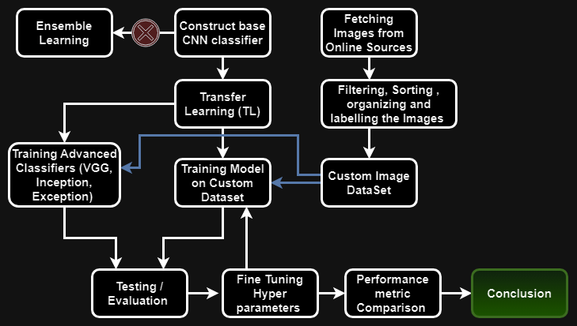
Methodology

Slide 14
Data Collection Strategy :
Custom Dataset Creation using Bing Image Downloader and Google Colab:
Advantage: Automated and scalable image collection using Python's Bing Image Downloader and Google Colab.
Limitation: Dependency on search engine results may lead to variations in image quality and relevance; efforts will be made to filter and refine the collected images.
Potential Risks: Inconsistencies in data quality may arise; rigorous preprocessing will be employed to maintain dataset integrity. Class imbalance is likely
Ethical Considerations:
Adhering to copyright and usage rights for downloaded images to avoid legal issues. Ensuring that image downloads comply with the terms of service of the search engine and respecting copyright and usage rights.

Slide 15
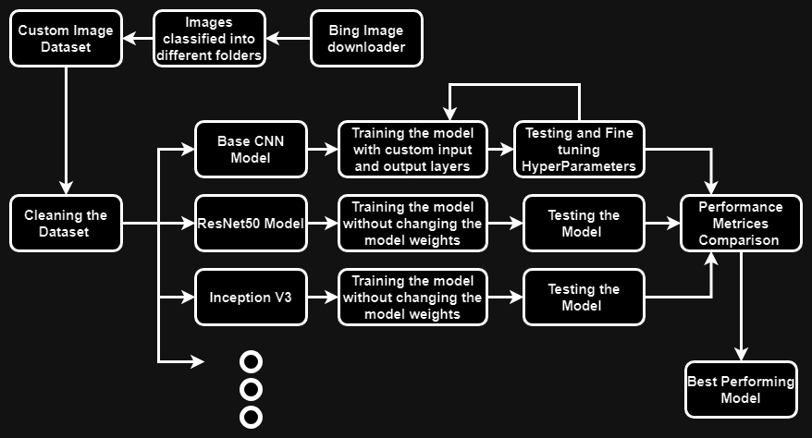
Proposed System

Slide 16
Implementations
Implemented :
Dataset_v1 (25K samples)
Dataset_v1 Cleaning → Dataset_v2 (22K samples)
Dataset_v2 Categorizing & Dataset_v2 Labelling
Custom Model (CNN-10)
EfficientNetB7 (Transfer Learning Model)
Partial Implementations (TL) :
EfficientNetB7 (Customized)
VGG-19 model
InceptionResNetV2 model
InceptionV3 model

Slide 17
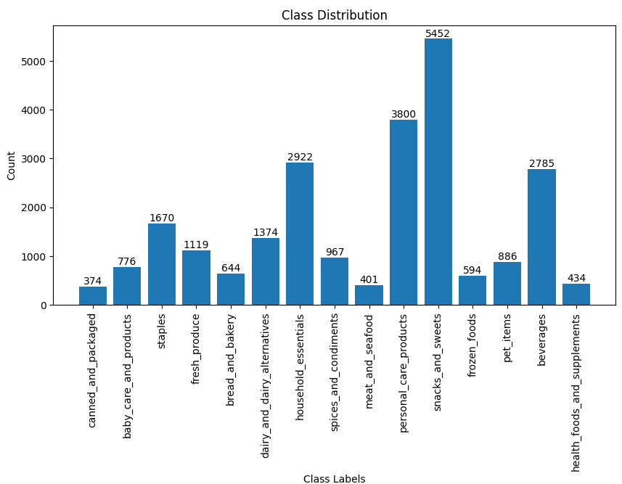
Dataset Class Distributions

Slide 18
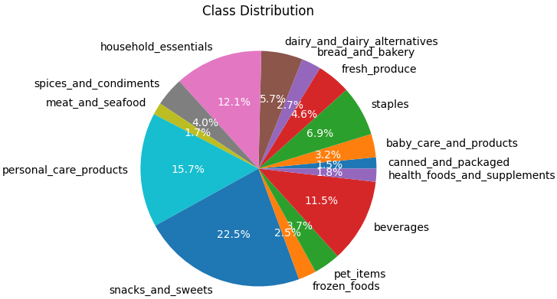
Dataset Class Distributions

Slide 19
Dataset Results
S no. | Class Label | No. of Images
1 | baby_care_and_products | 544
2 | beverages | 1935
3 | bread_and_bakery | 451
4 | canned_and_packaged | 261
5 | dairy_and_dairy_alternatives | 969
6 | fresh_produce | 782
7 | frozen_foods | 406
8 | health_foods_and_supplements | 303
9 | household_essentials | 2035
10 | meat_and_seafood | 280
11 | personal_care_products | 2649
12 | pet_items | 617
13 | snacks_and_sweets | 3802
14 | spices_and_condiments | 675
15 | staples | 1169
Training Data :

Slide 20
Dataset Results
S no. | Class Label | No. of Images
1 | baby_care_and_products | 232
2 | beverages | 828
3 | bread_and_bakery | 192
4 | canned_and_packaged | 111
5 | dairy_and_dairy_alternatives | 411
6 | fresh_produce | 335
7 | frozen_foods | 174
8 | health_foods_and_supplements | 129
9 | household_essentials | 872
10 | meat_and_seafood | 119
11 | personal_care_products | 1135
12 | pet_items | 264
13 | snacks_and_sweets | 1629
14 | spices_and_condiments | 288
15 | staples | 500
Testing Data :

Slide 21
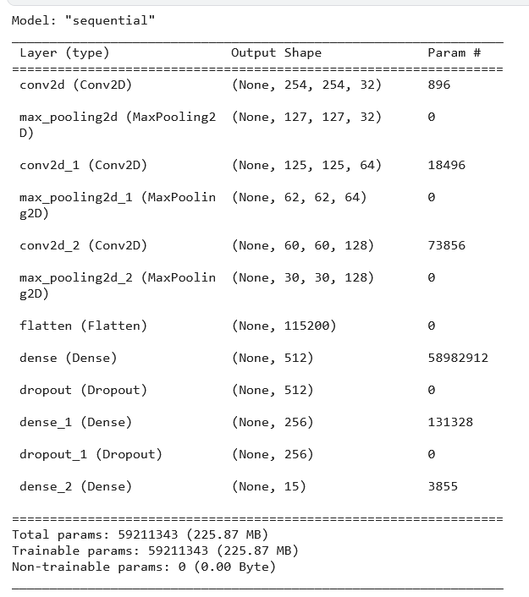
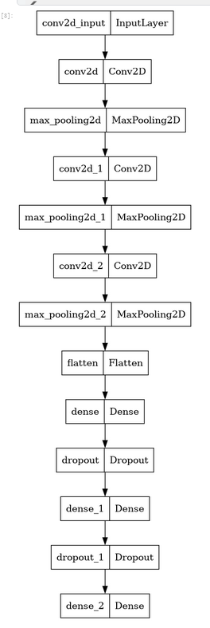
Model Summary
Custom CNN Model Summary
Custom CNN Model Structure

Slide 22
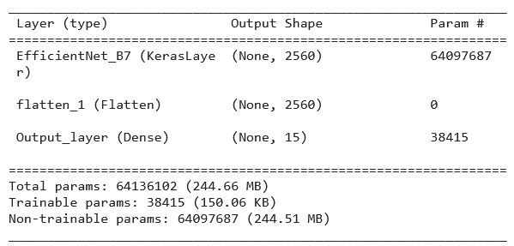
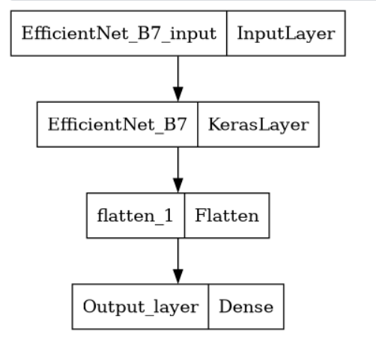
Model Summary
EfficientNetB7 Model (TL) Summary
EfficientNetB7 Model (TL) Structure

Slide 23
Results
CNN Basic Results :
EfficientNetB7 Basic Model_v2 (Customized) Results
S no. | Category | Score
1 | Train Loss | 1.28
2 | Train Accuracy | 58.87%
1 | Test Loss | 1.511
2 | Test Accuracy | 53.6 %
S no. | Category | Score
1 | Train Loss | 0.0568
2 | Train Accuracy | 98.26%
1 | Test Loss | 1.96
2 | Test Accuracy | 59.98% ≈ 60%

Slide 24
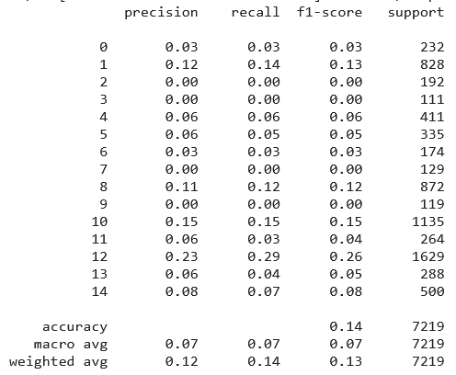
Results & Interpretations
CNN Advanced Results :
The precision, recall, and F1-score values are quite low for most classes, indicating that the model's predictions are not very accurate or reliable.
The overall accuracy is also low, suggesting that the model's predictions do not align well with the actual labels.
The AUC score is close to 0.5, which indicates that the model's ability to distinguish between positive and negative classes is not much better than random guessing.

Slide 25
Findings and Improvements Planned
Causes for Poor Performance of Models :
The imbalanced classes in the custom dataset are the major contributing factor to the poor model performance.
Imbalanced classes lead to biased predictions, where the model tends to favor the majority class and performs poorly on minority classes.
This also the reason for overfitting in case of Deeper models (TL)
Suggestions for Improvement :
Implement class balancing techniques such as over-sampling, under-sampling, or generating synthetic samples to address class imbalance.
Utilize data augmentation techniques to increase the diversity of the training data and improve model generalization.
Experiment with different model architectures, hyperparameters, and optimization strategies to enhance model performance.
Consider unfreezing TL layers during the end of training, so that models better adapt to the dataset.

Slide 26
What Is Next
Complete the making of custom dataset
Rigorous preprocessing and Filtrations of images
Implementation of Advanced DNN models (ResNet50, VGGNet)

Slide 27
References
[0]Base Paper : Wiryana, Made & Harmanto, Suryadi & Fauzi, Alfharizky & Qisthi, Imam & Utami, Zalita. (2023). Store product classification using convolutional neural network. IAES International Journal of Artificial Intelligence (IJ-AI). 12. 1439. 10.11591/ijai.v12.i3.pp1439-1447.
Available : here
[1]Muhathir, M. F. Dwi Ryandra, R. B. Y. Syah, N. Khairina, and R. Muliono, “Convolutional Neural Network (CNN) of Resnet-50 with Inceptionv3 Architecture in Classification on X-Ray Image,” Convolutional Neural Network (CNN) of Resnet-50 with Inceptionv3 Architecture in Classification on X-Ray Image | SpringerLink, Jul. 09, 2023. [Online]. Available: https://link.springer.com/chapter/10.1007/978-3-031-35314-7_20
[2]“An effective CNN and Transformer complementary network for medical image segmentation,” An effective CNN and Transformer complementary network for medical image segmentation - ScienceDirect, Nov. 30, 2022. [Online]. Available: https://www.sciencedirect.com/science/article/abs/pii/S0031320322007075
[3]“Comparison of CNN-based deep learning architectures for rice diseases classification,” Comparison of CNN-based deep learning architectures for rice diseases classification - ScienceDirect, Jul. 14, 2023. [Online]. Available: https://www.sciencedirect.com/science/article/pii/S2589721723000235
[4]S. E. Abdallah, W. M. Elmessery, M. Y. Shams, and N. S. A. Al-Sattary, “Deep Learning Model Based on ResNet-50 for Beef Quality Classification,” Arab Journals Platform, Oct. 08, 2022. [Online]. Available: https://digitalcommons.aaru.edu.jo/isl/vol12/iss1/24
[5]S. Kumar, S. Pal, V. P. Singh, and P. Jaiswal, “Performance evaluation of ResNet model for classification of tomato plant disease,” De Gruyter, Jan. 01, 2023. [Online]. Available: https://www.degruyter.com/document/doi/10.1515/em-2021-0044/html
[6]V. Anand, S. Gupta, A. Altameem, S. R. Nayak, R. C. Poonia, and A. K. Jilani Saudagar, “An Enhanced Transfer Learning Based Classification for Diagnosis of Skin Cancer,” MDPI, Jul. 05, 2022. [Online]. Available: https://www.mdpi.com/2075-4418/12/7/1628

Slide 28
[7]A. W. Salehi et al., “A Study of CNN and Transfer Learning in Medical Imaging: Advantages, Challenges, Future Scope,” MDPI, Mar. 29, 2023. [Online]. Available: https://www.mdpi.com/2071-1050/15/7/5930
[8]M. M. Srikantamurthy, V. P. Subramanyam Rallabandi, D. B. Dudekula, S. Natarajan, and J. Park, “Classification of benign and malignant subtypes of breast cancer histopathology imaging using hybrid CNN-LSTM based transfer learning - BMC Medical Imaging,” SpringerLink, Jan. 30, 2023. [Online]. Available: https://link.springer.com/article/10.1186/s12880-023-00964-0
[9]“Fusion of U-Net and CNN model for segmentation and classification of skin lesion from dermoscopy images,” Fusion of U-Net and CNN model for segmentation and classification of skin lesion from dermoscopy images - ScienceDirect, Nov. 09, 2022. [Online]. Available: https://www.sciencedirect.com/science/article/abs/pii/S0957417422022485
[10] A. Patra, V. Vivek, B. R. Shambhavi, K. Sindhu, and S. Balaji, “Product Classification in E-Commerce Sites,” Product Classification in E-Commerce Sites | SpringerLink, Apr. 16, 2021. [Online]. Available: https://link.springer.com/chapter/10.1007/978-981-33-4299-6_40
[11] A. Motwani, G. Bajaj, M. Arya, S. K. Sar, and S. O. Manoj, “Machine Learning-Based Autonomous Framework for Product Classification Over Cloud,” Machine Learning-Based Autonomous Framework for Product Classification Over Cloud | SpringerLink, May 31, 2023. [Online]. Available: https://link.springer.com/chapter/10.1007/978-981-19-9638-2_6
[12]M. I. Basheer Ahmed et al., “Deep Learning Approach to Recyclable Products Classification: Towards Sustainable Waste Management,” MDPI, Jul. 17, 2023. [Online]. Available: https://www.mdpi.com/2071-1050/15/14/11138
[13]“Convolutional Neural Network (CNN) Based Identification of Crop Diseases Using ResNet-50,” Convolutional Neural Network (CNN) Based Identification of Crop Diseases Using ResNet-50 | IEEE Conference Publication | IEEE Xplore. [Online]. Available: https://ieeexplore.ieee.org/abstract/document/10370122
[14] Kılıçarslan G, Koç C, Özyurt F, Gül Y. Breast lesion classification using features fusion and selection of ensemble ResNet method. Int J Imaging Syst Technol. 2023; 33(5): 1779-1795. doi:10.1002/ima.22894
[15] R. S. Sabeenian, Eldho Paul & C. Prakash (2023) Fabric defect detection and classification using modified VGG network, The Journal of The Textile Institute, 114:7, 1032-1040, DOI: 10.1080/00405000.2022.2105112
[16] Zheng, Yufeng & Yang, Clifford & Merkulov, Aleksey. (2018). Breast cancer screening using convolutional neural network and follow-up digital mammography. 4. 10.1117/12.2304564.
[17] Khalil, Muhammad & Tehsin, Samabia & Humayun, Mamoona & Jhanjhi, Noor & AlZain, Mohammed. (2022). Multi-Scale Network for Thoracic Organs Segmentation. Computers, Materials and Continua. 70. 3251-3265. 10.32604/cmc.2022.020561.
[18] Tan, M., & Le, Q. (2019, May). Efficientnet: Rethinking model scaling for convolutional neural networks. In International conference on machine learning (pp. 6105-6114). PMLR.
[19] Szegedy, C., Ioffe, S., Vanhoucke, V., & Alemi, A. (2017, February). Inception-v4, inception-resnet and the impact of residual connections on learning. In Proceedings of the AAAI conference on artificial intelligence (Vol. 31, No. 1).

